Slide 1

Samuel Khalil, Mary Shiner, Brandon Furdock

Slide 2
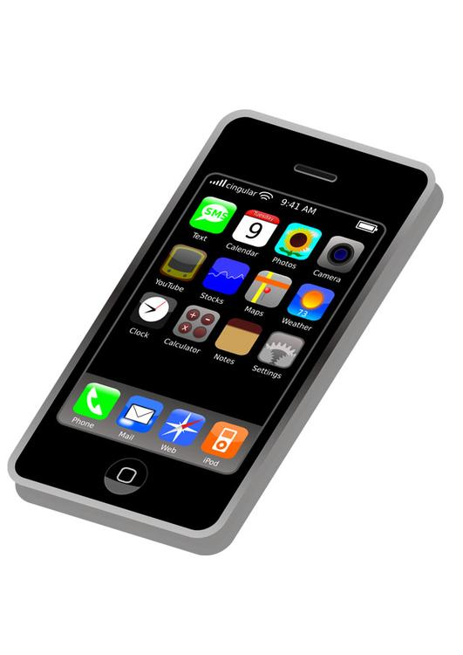
Project Title
Chatter is a chat application that allows iOS users to chat in a simple and efficient manner. Chatter places the trust of its users in the highest regard, and includes a detailed companion website which clearly describes to users how their data is being handled.

Slide 3

Team Members & Roles
Samuel Khalil - Coder
Mary Shiner - Team Management
Brandon Furdock - Documentation

Slide 4

Problem Statement
Many communication applications are often so complex as to alienate new users
The vision of Chatter is to create a simple, transparent mobile messaging application which addresses this concern
This system shall
allow users to communicate simply
Include a website which clearly explains how user data is handled
encourage user feedback

Slide 5

Objectives
Create a functional mobile messaging application
Utilize the tools of iOS development
Use HTML, CSS, and PHP to develop a website
Create meaningful documentation to describe the Chatter system
Present results using effective presentation aids

Slide 6
Functional Requirements
The system shall allow sending of messages between users
The system should allow for creation of groups
The website should offer details of the operation of the application
The user feedback section on the website shall allow for improvement of functionalities

Slide 7

Non-functional Requirements
The system should provide transparent use of user data
The system shall allow users to quickly begin using the application (less than 5 minutes)
The application should provide fast, efficient transmission of messages between users (less than 5 seconds)
The application should be small in download size (less than 100 MB)
The system should be available more than 95% of the time

Slide 8

Target Environment
iOS is currently active on over a billion devices worldwide, and is the target environment for the Chatter application. The iOS ecosystem provides a stable platform for the first implementation of the Chatter application. Although not a goal of this first iteration, an easy future transition to the desktop environment could be enabled through the 2019 integration of UIkit into OSX.

Slide 9



Technologies & Tools
Swift
UIKit
HTML
CSS
PHP
Firebase

Slide 10
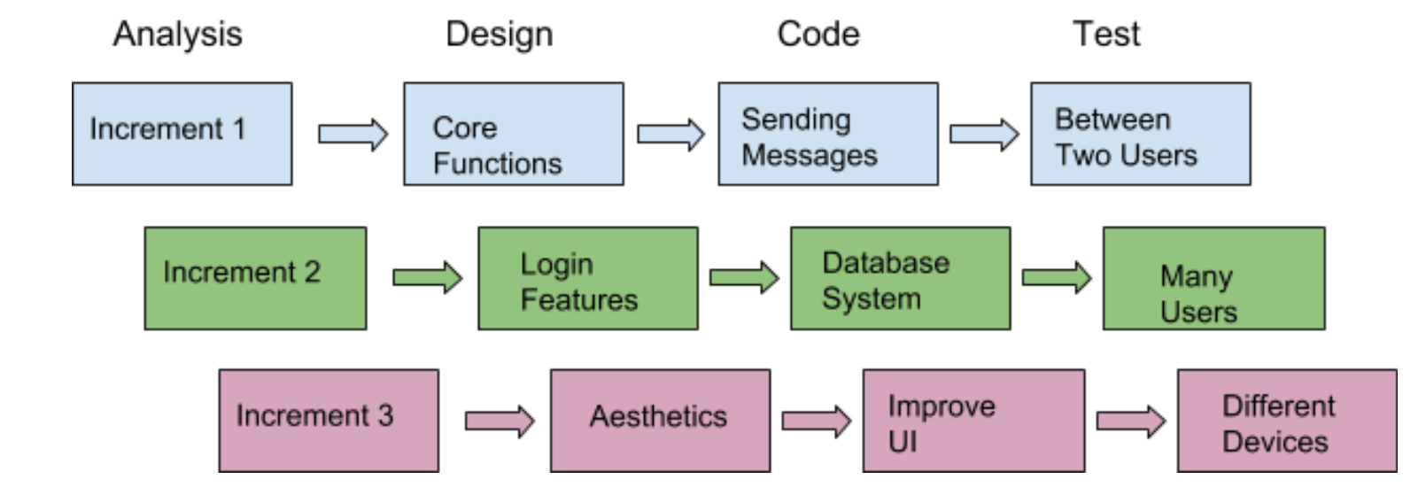
Process Model & Schedule
Incremental Process

Slide 11

Risk Analysis
Ambitious project with only 3 members
Implementing messaging could be harder than expected
Only one month until product must be delivered
Effective time management
Role overlap in Small Group
Targeting Multiple Devices
Different Screen Sizes

Slide 12

References
“HTML,” W3Schools Online Web Tutorials. [Online]. Available: http://www.w3schools.com/. [Accessed: 15-Jul-2018].
Apple Inc, “Swift - Apple Developer,” Purchase and Activation - Support - Apple Developer. [Online]. Available: https://developer.apple.com/swift/. [Accessed: 15-Jul-2018].
CSI 3370 Lecture/Course Materials

